Slide 1


Intensive Course Biology for Technology Department of Agricultural Technology Faculty of Technology, University of Colombo by Dr. Aruna Kumara Udawasala

Slide 2
Introduction to Biology

Slide 3
Why a Study of Biology is Important?
Societal
Medicine
Public Health
Worldwide Water Crisis
1-

Slide 4
Why a Study of Biology is Important?
Philosophical
Evolution
Genetics
.

Slide 5
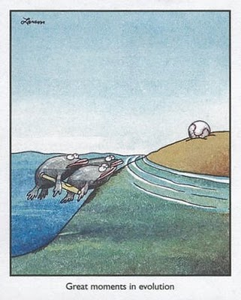
1-

Slide 6
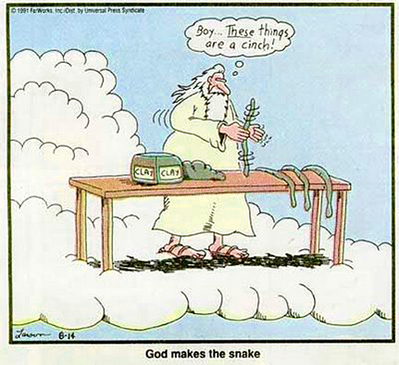
1-

Slide 7
Why a Study of Biology is Important?
Personal
To be informed
Support your cause
Make it your life work
1-

Slide 8
[bahy-ol-uh-jee]
Bio = life
...ology = the study of
Biology is the science that studies life
Biology is the natural science that studies the no-spontaneous transfer of energy and the quasi-stable systems that experience it.
1-

Slide 9
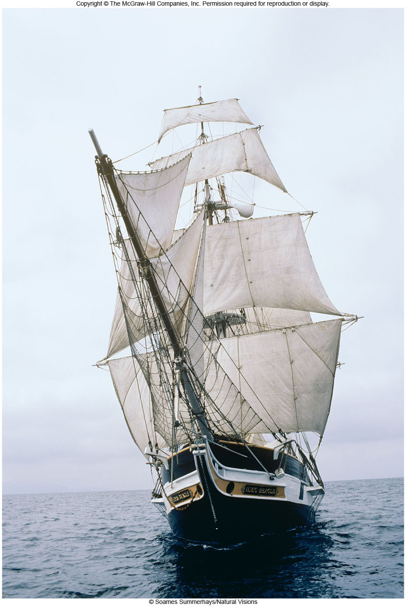
The Science of Biology

Slide 10
The Science of Life
Biology unifies much of natural life
Biology attempts to define life
Biology Living reveals a hierarchical organization of living systems
2

Slide 11
Properties of Life
Living organisms:
are composed of cells (Cellular Organization)
are complex and ordered (Ordered Complexity)
respond to their environment (Sensitivity)
can Grow, Develop and Reproduce
obtain and use energy (Energy Utilization)
maintain internal balance (Homeostasis)
allow for Evolutionary Adaptation
The definitions of life are adapting with the field
where do viruses fit in?

Slide 12
Levels of Organization
Cellular Level
Atoms molecules organelles cells
Organismal Level
Tissues organs organ systems
Population Level
Population species biological community
Ecosystem Level
Biological community + physical habitat (soil, water, atmosphere)
The Biosphere
The entire planet thought of as an ecosystem
4

Slide 13
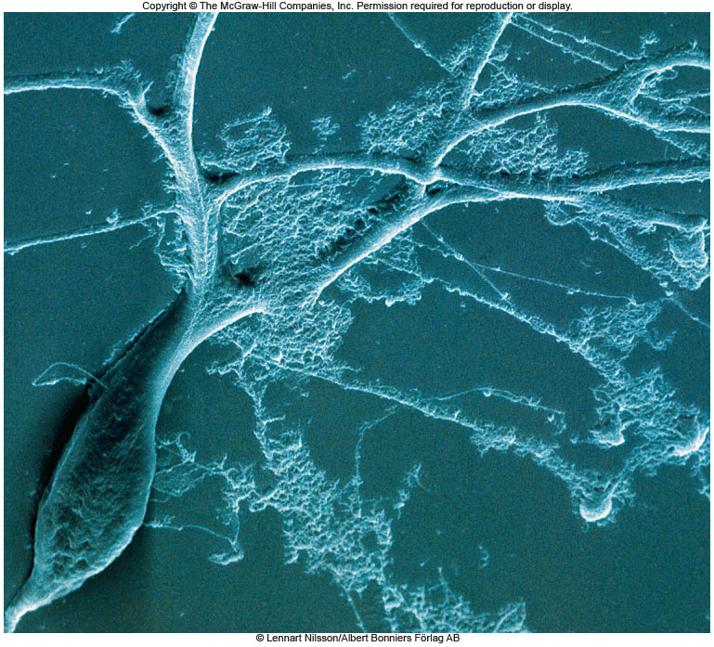
Levels of Organization
Cellular Organization
cells
organelles
molecules
atoms
The cell is the
basic unit of life.

Slide 14
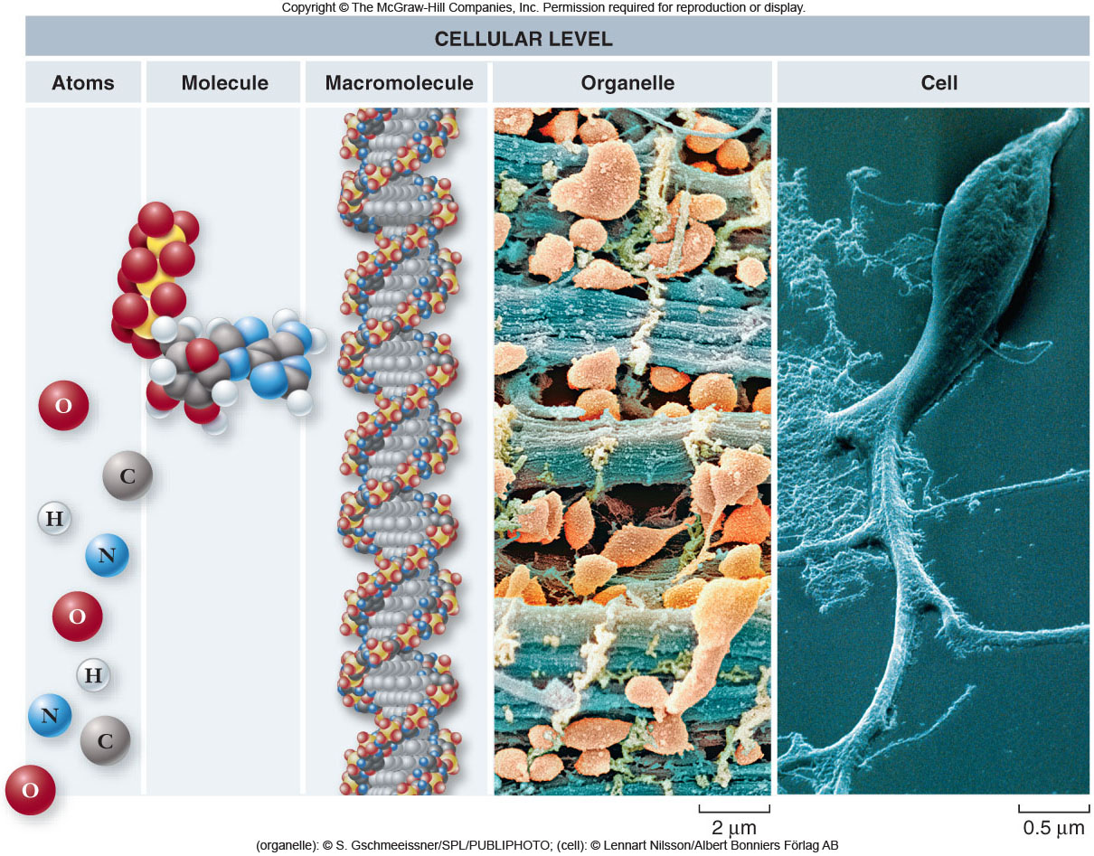
6

Slide 15
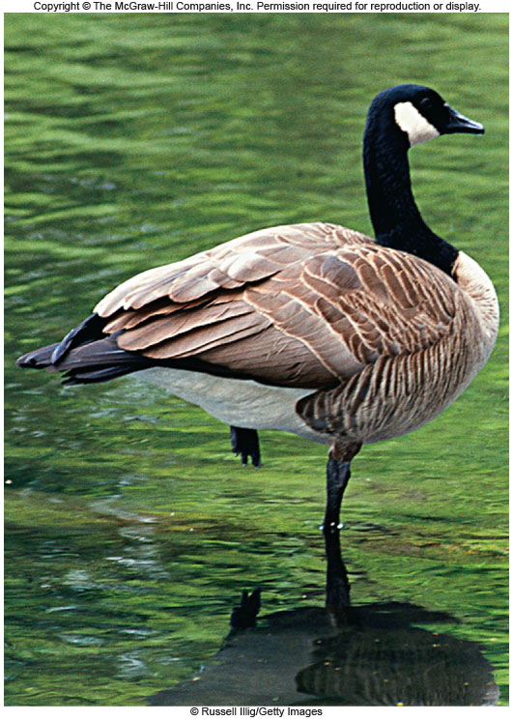
Levels of Organization
Organismal Level
organism
organ systems
organs
tissues

Slide 16
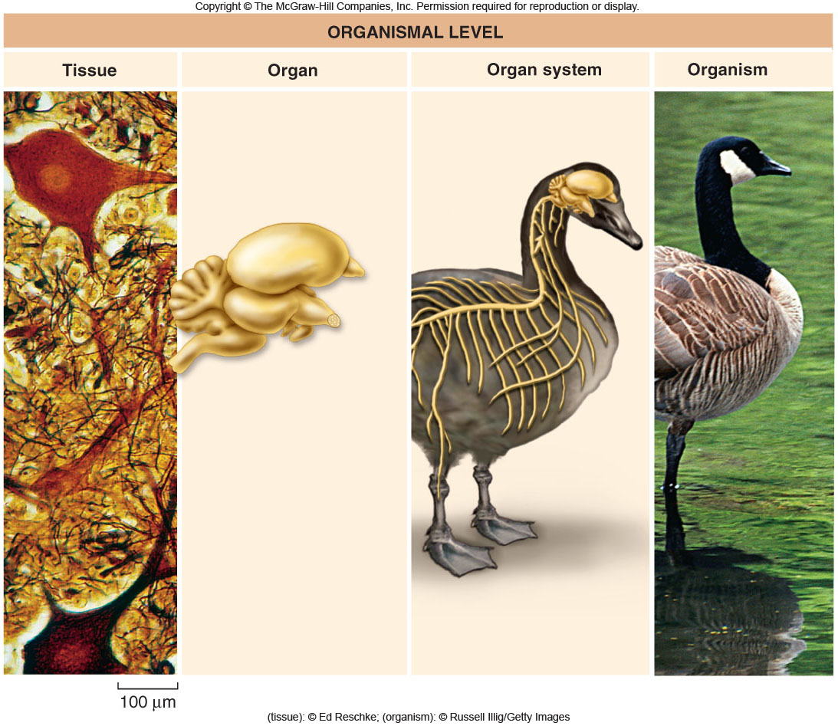
8

Slide 17

Levels of Organization
Population Level
ecosystem
community
species
population

Slide 18
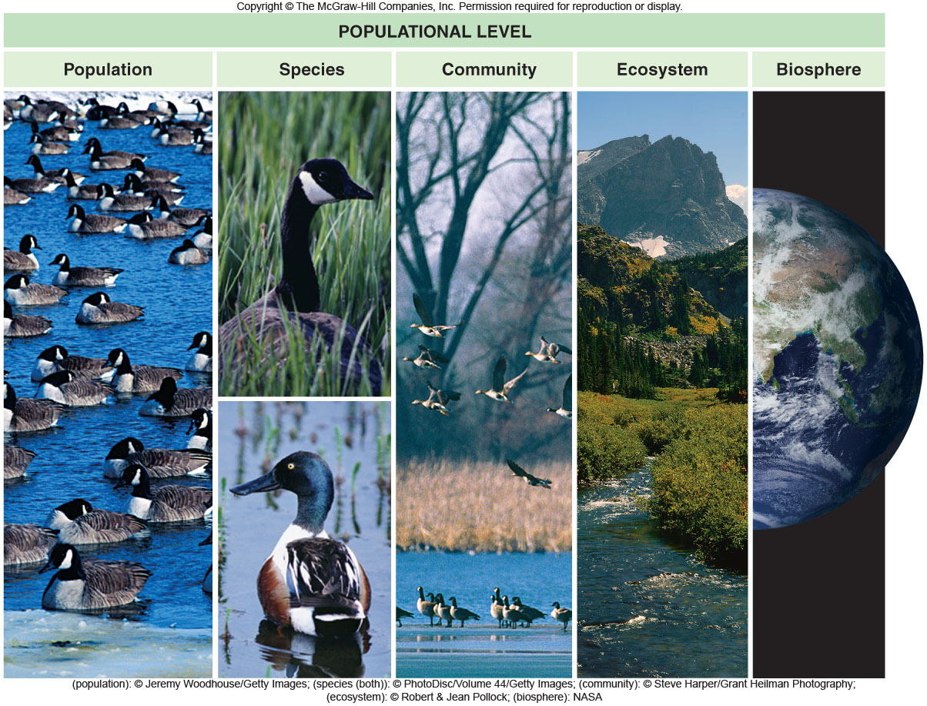
10

Slide 19
Levels of Organization
Each level of organization builds on the level below it but often demonstrates new features
Emergent properties: new properties present at one level that are not seen in the previous level
New properties emerging may be greater than the sum of the the parts

Slide 20
The Nature of Science
Science aims to understand the natural world through observation and reasoning
Science begins with observations, therefore, much of science is purely descriptive
Science uses both deductive and inductive reasoning

Slide 21
The Nature of Science
Deductive reasoning uses general principles to make specific predictions.
Inductive reasoning uses specific observations to develop general conclusions.

Slide 22
The Nature of Science
Scientists use a systematic approach to gain understanding of the natural world:
Observation
Hypothesis formation
Prediction
Experimentation
Conclusion

Slide 23
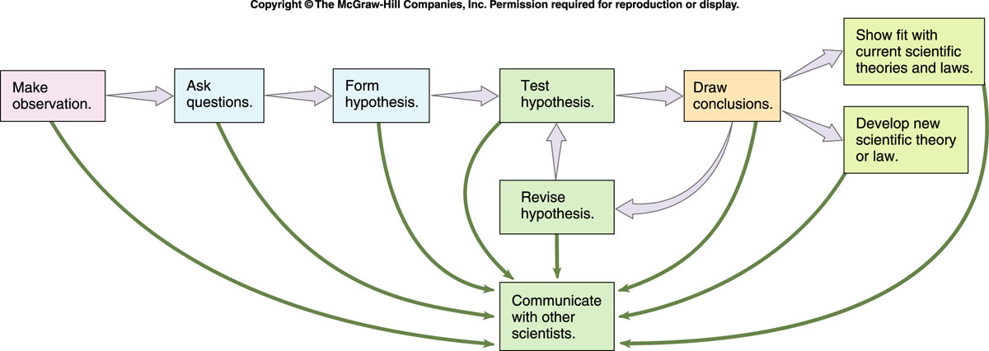

The Scientific Method in Action
A systematic way of gaining information
1-

Slide 24
The Nature of Science
A hypothesis is a possible explanation for an observation.
A hypothesis:
must be tested to determine its validity
is often tested in many different ways
allows for predictions to be made

Slide 25
The Nature of Science
The experiment:
tests the hypothesis
must be carefully designed to test only one variable at a time
consists of a test experiment and a control experiment

Slide 26
The Nature of Science
If the hypothesis is valid, the scientist can predict the result of the experiment
Conducting the experiment to determine if it yields the predicted result is one way to test the validity of the experiment

Slide 27
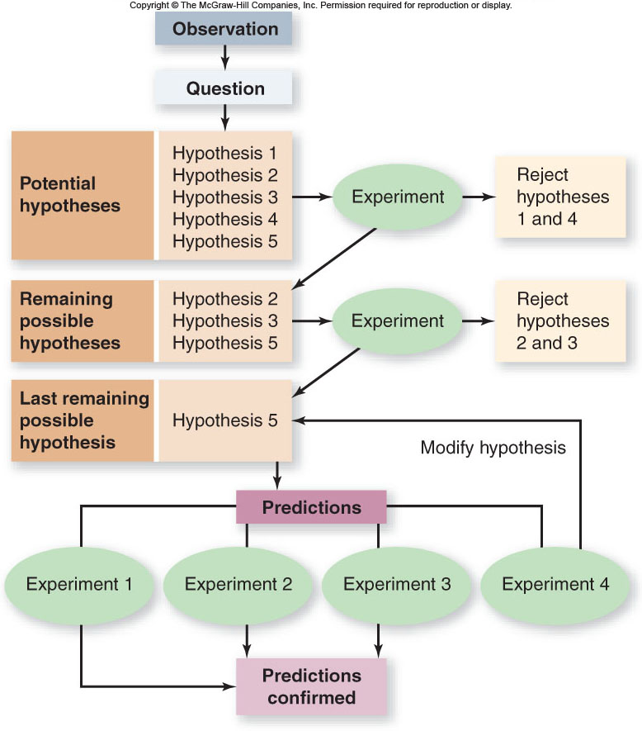
Think Like a Scientist

Slide 28
The Nature of Science
Scientists may use:
reductionism - to break a complex process down to its simpler parts
models – to simulate phenomena that are difficult to study directly

Slide 29
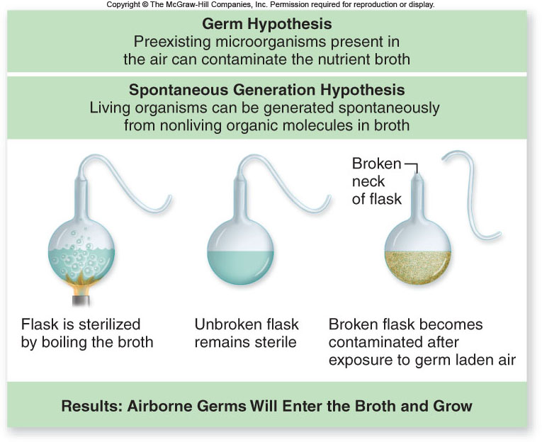
Test the early hypothesis of Spontaneous Generation
Fig. 1.4

Slide 30
The Nature of Science
A scientific theory:
is a body of interconnected concepts
is supported by much experimental evidence and scientific reasoning
expresses ideas of which we are most certain

Slide 31
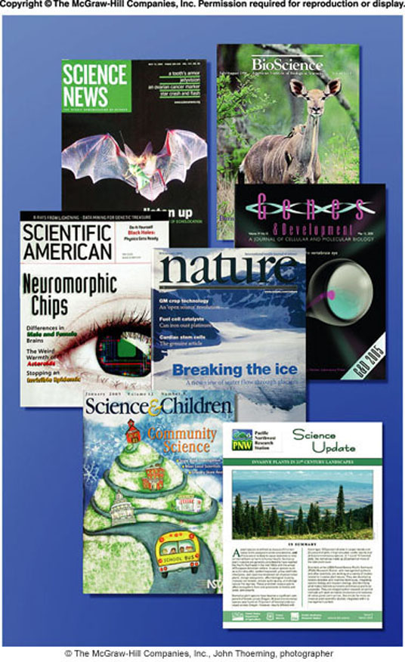
Scientific Communication
Data is shared with the scientific community through research articles published in scientific journals.
peer review
Scientists present preliminary data at conferences.
Scientists collaborate directly by phone and e-mail.
1-

Slide 32
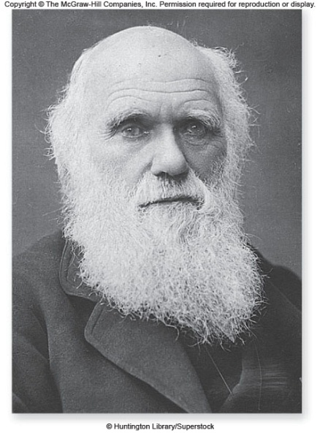
An Example of Scientific Inquiry: Darwin and Evolution
Charles Darwin served as naturalist on mapping expedition around coastal South America.
Used many observations to develop his ideas
Proposed that evolution occurs by natural selection

Slide 33
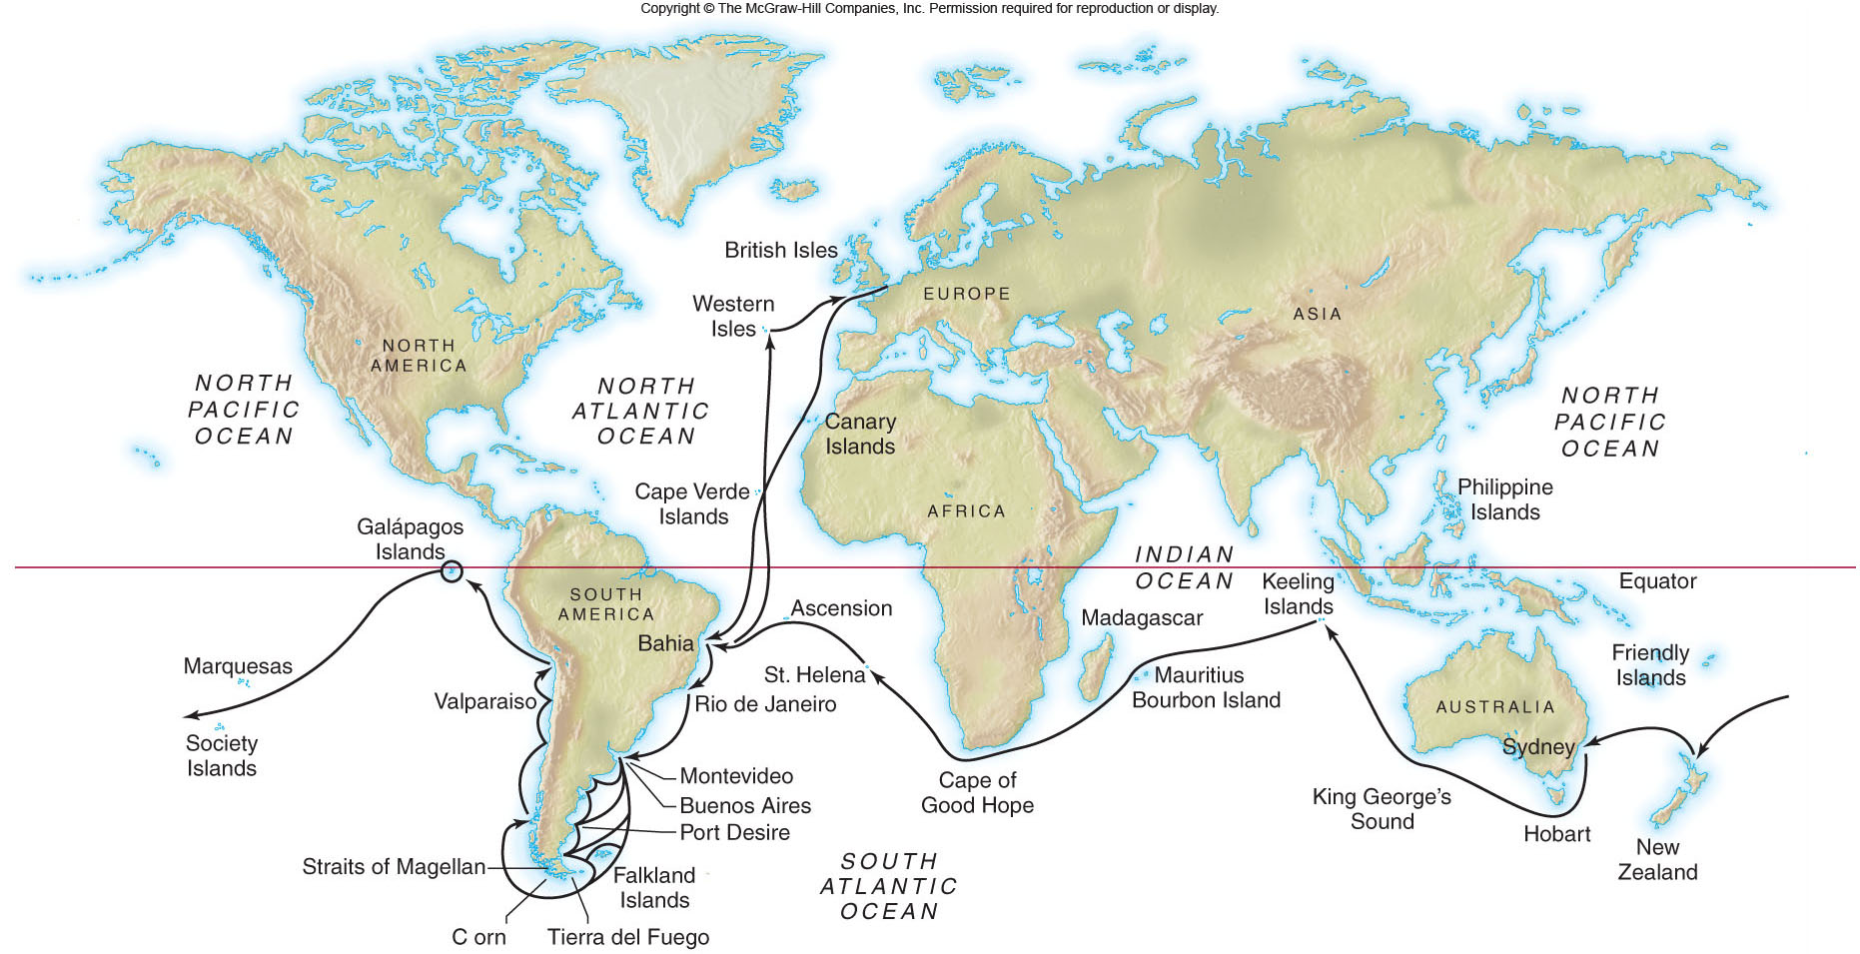
Voyage of the Beagle

Slide 34
Charles Darwin
Evolution: Modification of a species over generations
“descent with modification”
Natural Selection: Individuals with superior physical or behavioral characteristics are more likely to survive and reproduce than those without such characteristics

Slide 35
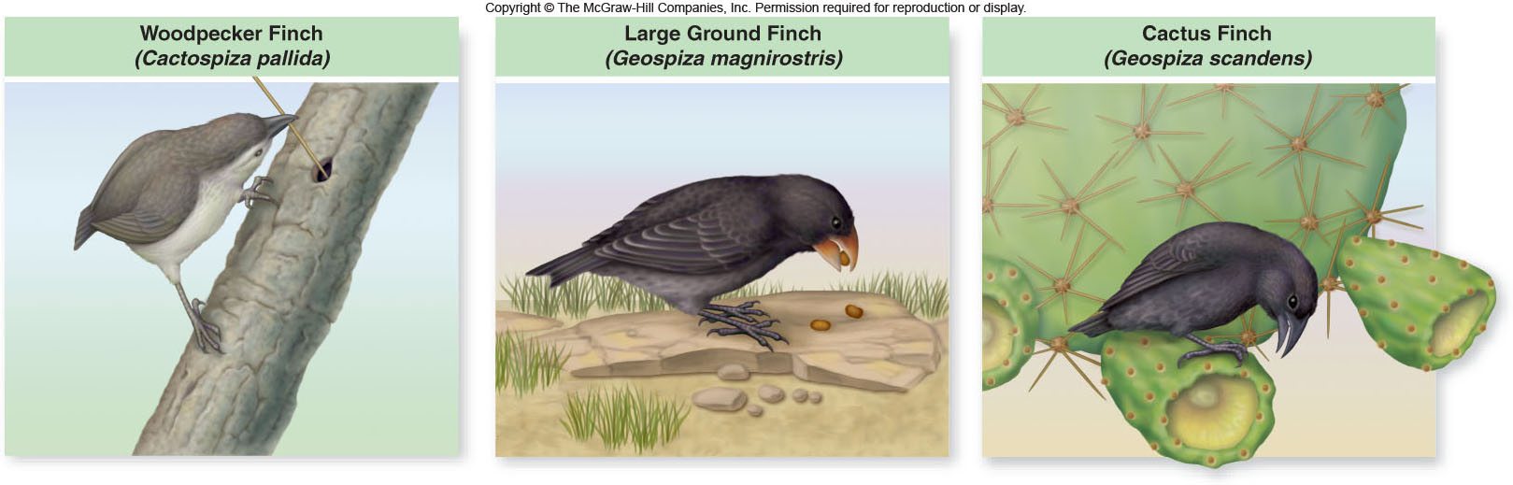
Darwin’s Evidence
Similarity of related species
Darwin noticed variations in related species living in different locations

Slide 36
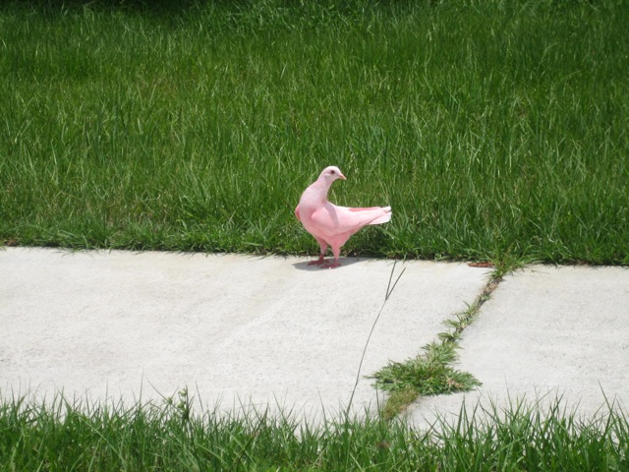
Unnatural Selection

Slide 37
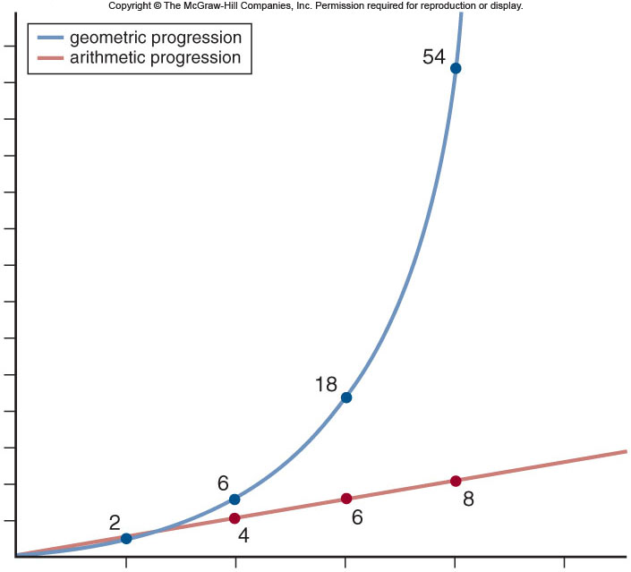
Darwin’s Evidence
Thomas Malthus:
Population growth vs. availability of resources
-population growth
is geometric
-increase in food
supply is arithmetic

Slide 38
Darwin’s Evidence
Population growth vs. availability of resources
Darwin realized that not all members of a population survive and reproduce
Deduced that the organisms best adapted to obtaining resources would survive to reproduce
Darwin based these ideas on the writings of Thomas Malthus

Slide 39
Post-Darwin Evolution Evidence
Fossil record
Intermediate Organisms
Mechanisms of heredity
- Early criticism of Darwin’s ideas were resolved by Mendel’s theories for genetic inheritance

Slide 40
Post-Darwin Evolution Evidence
Comparative anatomy
- Homologous structures have same evolutionary origin, but different structure and function.
- Analogous structures have similar structure and function, but different evolutionary origin.

Slide 41
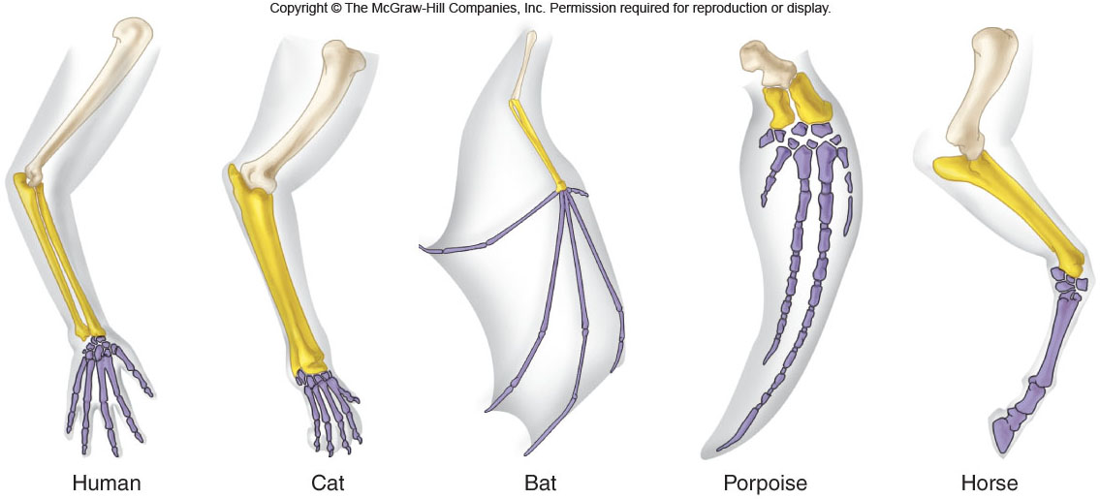
Homologous Structures

Slide 42
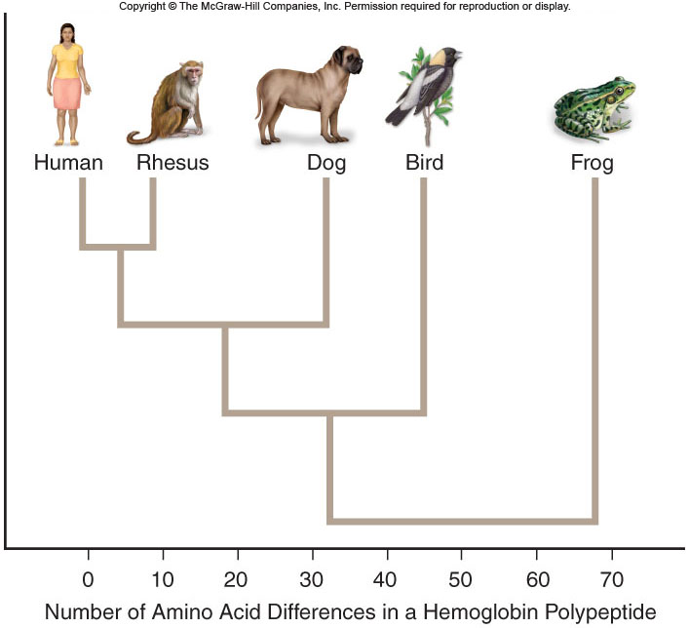
Post-Darwin Evolution Evidence
Molecular Evidence
- Our increased understanding of DNA and protein structures has led to the development of more accurate phylogenetic trees.

Slide 43
Unifying Themes in Biology
Cell theory
The cell theory describes the organization of living systems
All living organisms are made of cells, and all living cells come from preexisting cells

Slide 44
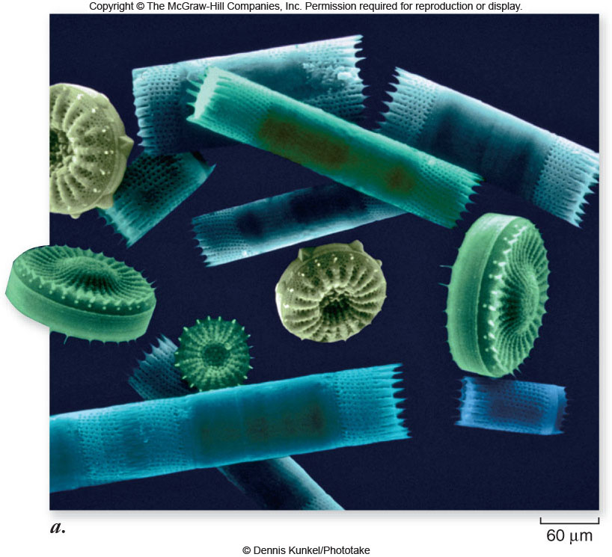
Fig. 1.11a
Single Celled Organisms
34

Slide 45
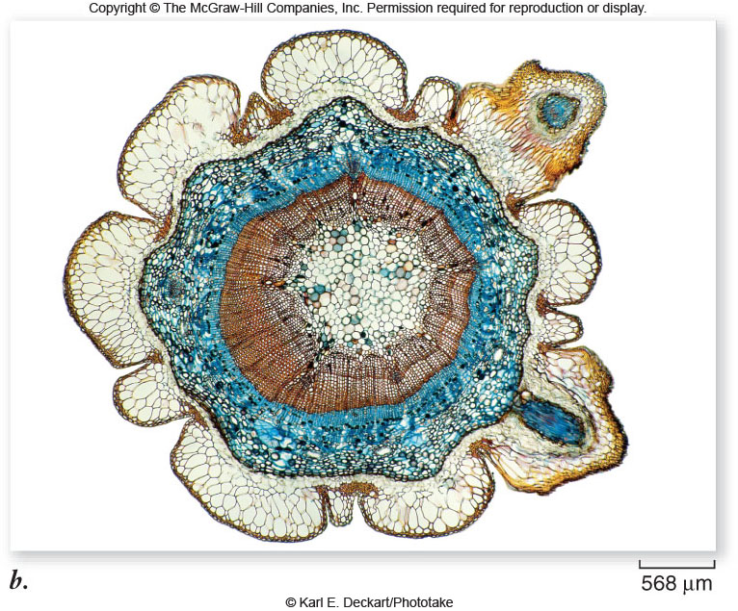
Fig. 1.11b
Multi-Cellular Organisms
35

Slide 46
1.4 Unifying Themes in Biology
Molecular basis of inheritance
The molecular basis of inheritance explains the continuity of life
DNA encodes genes which control living organisms and are passed from one generation to the next
The DNA code is similar for all organisms (The Central Dogma)

Slide 47
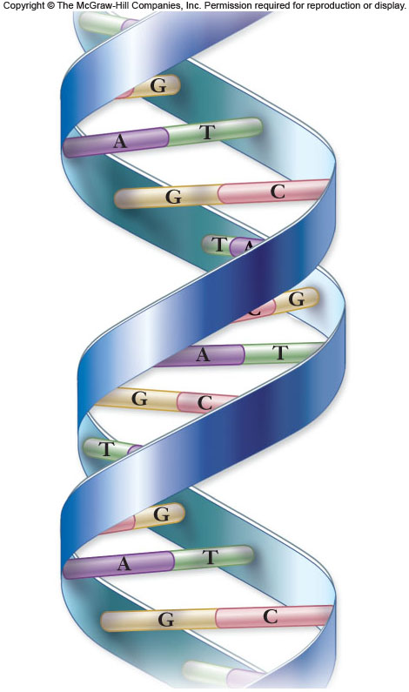
Fig. 1.12
37

Slide 48
Unifying Themes in Biology
Structure and Function
The proper function of a molecule is dependent on its structure
The structure of a molecule can often tell us about its function
Four major classes of Biomolecules
Nucleic Acids
Amino Acids
Lipids
Carbohydrates

Slide 49
Unifying Themes in Biology
Evolutionary Change
The diversity of life arises by evolutionary change leading to the present biodiversity we see
Biology attempts to classify life’s great diversity based on these unifying themes
Currently all living things are classified into 3 Domains subdivided into Kingdoms (more on taxonomy to come)
This process is always changing

Slide 50
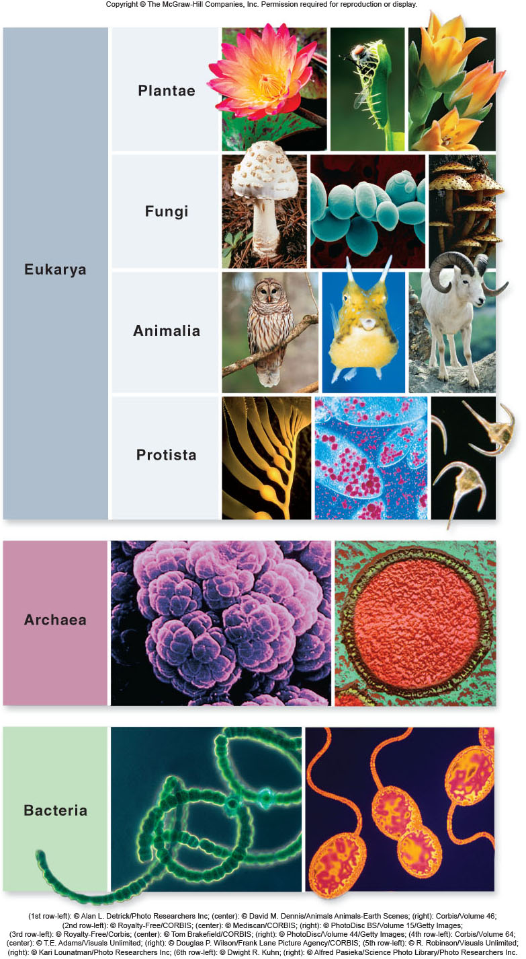
Fig. 1.13
The Diversity of Life
Three Domains:
1. Eukarya
2. Archaea
3. Bacteria
40

Slide 51
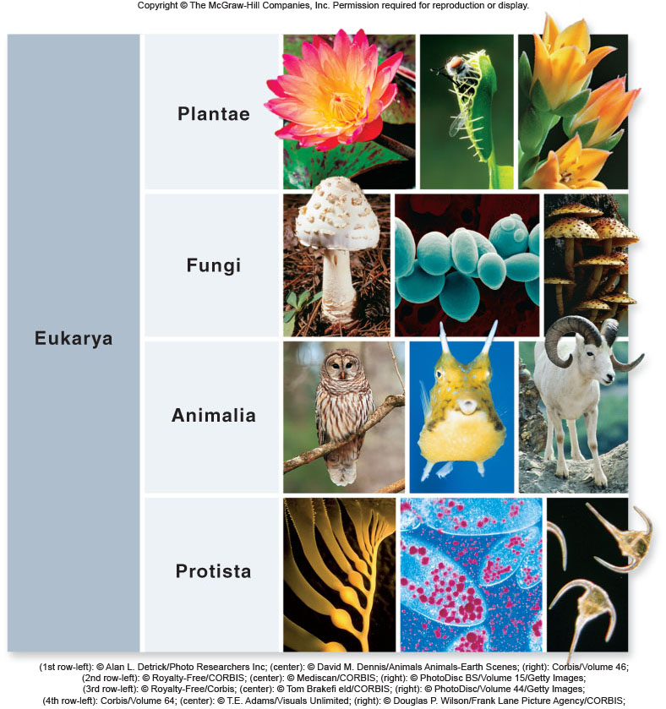
Fig. 1.13-1
Domain Eukarya is
Divided into four
Kingdoms:
1. Plantae
2. Fungi
3. Animalia
4. Protista
41

Slide 52
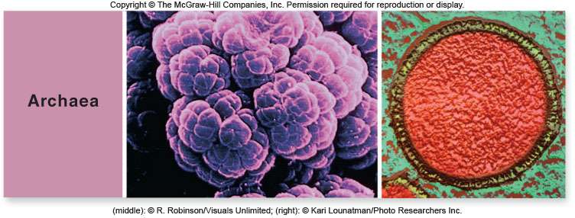
Fig. 1.13-2
42

Slide 53
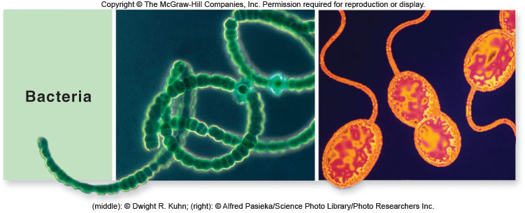
Fig. 1.13-3
43

Slide 54
Unifying Themes in Biology
Evolutionary Conservation
Evolutionary conservation explains the unity of living systems
The underlying unity of biochemistry and genetics argues that all life has evolved from the same origin event
Critical characteristics of early organisms are conserved and passed on to future generations

Slide 55
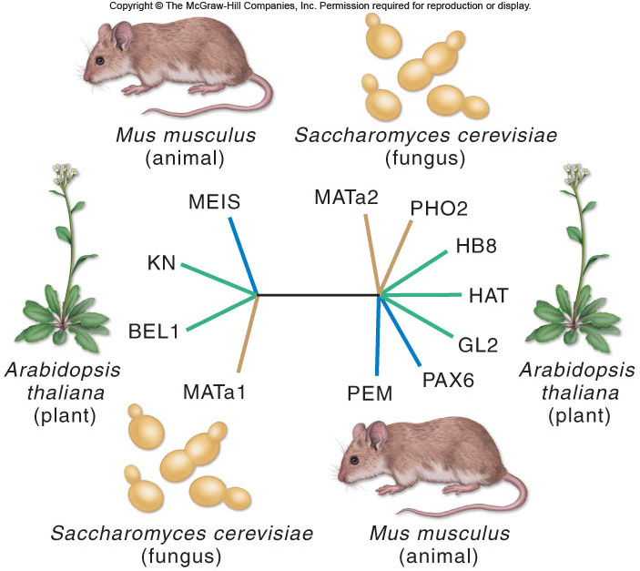
Fig. 1.14
Homeodomains
45

Slide 56
Unifying Themes in Biology
Cells are information-processing systems
Every cell in an organism carries the same genetic information
The control of gene expression allows cells to differentiate into different cell and tissue types
Cells also process information received from the environment and respond to maintain homeostasis

Slide 57
Unifying Themes in Biology
Emergent properties
New properties are present at one level of organization that are not seen in the previous level
The whole is greater than the sum of its parts

Slide 58
The Science of Biology

